Slide 1

MINOR PROJECT I
PROBLEM STATEMENT:
The chief minister of the state is wanting to have a detailed overview of COVID 19 in the state for the month of June and July (Till 15 July 2020) 2020 to plan the strategy for safeguarding the people of the state.
SUBMITTED BY:
Ritul Mukherjee

Slide 2
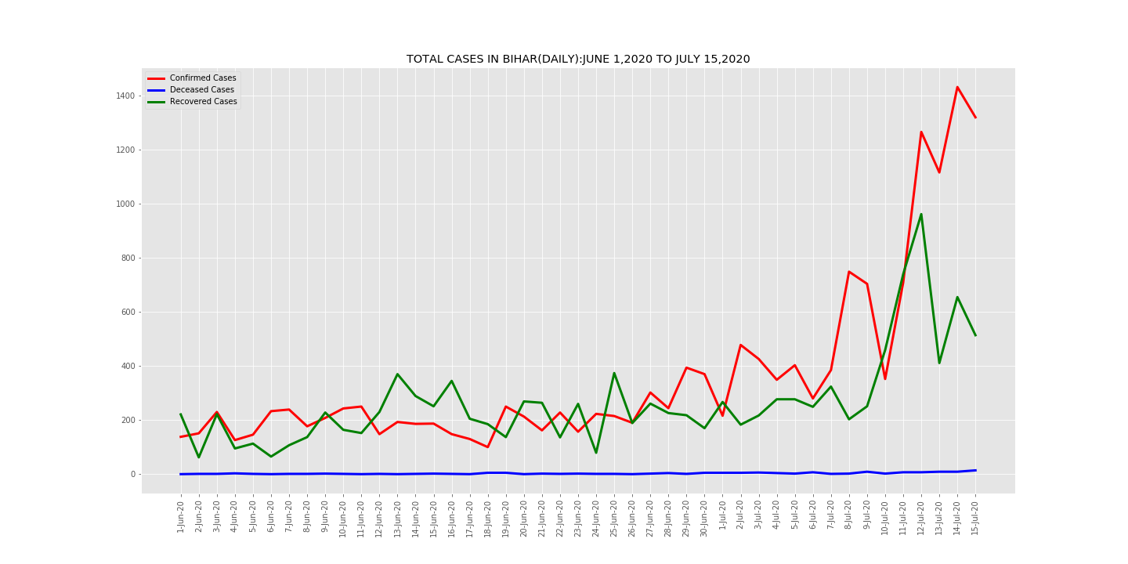
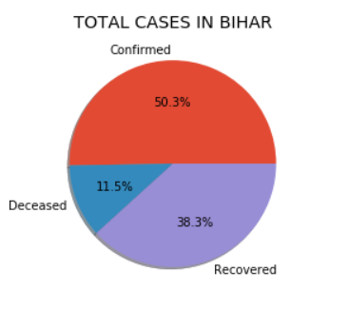
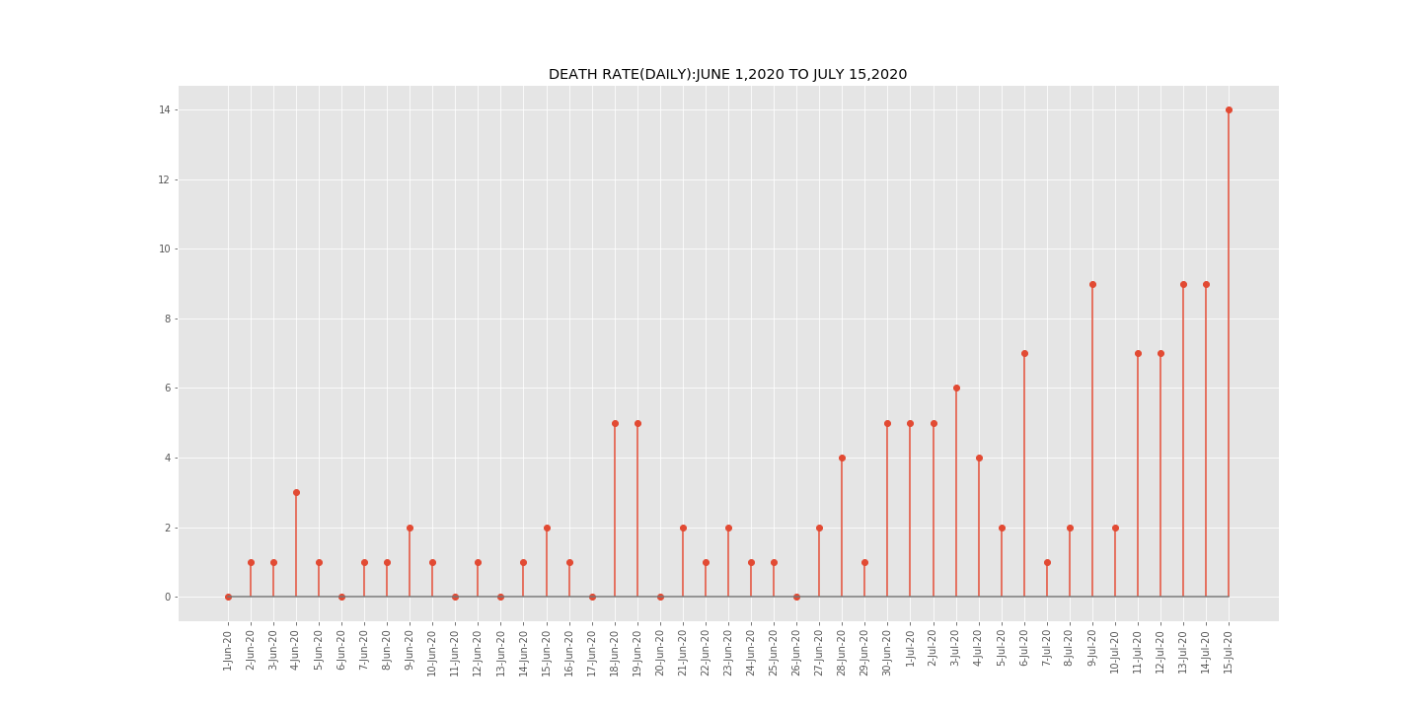
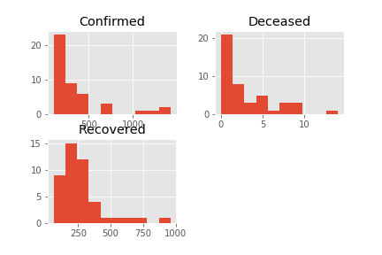
DAY-WISE ANALYSIS OF BIHAR

Slide 3
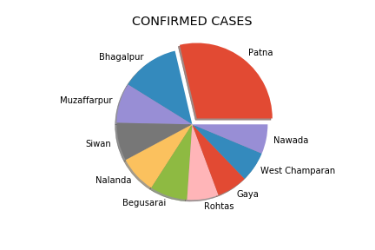
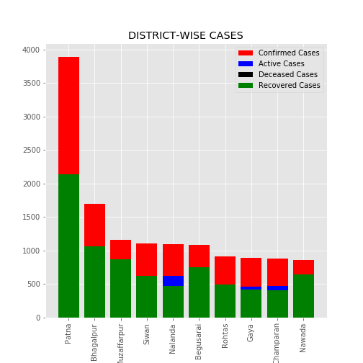
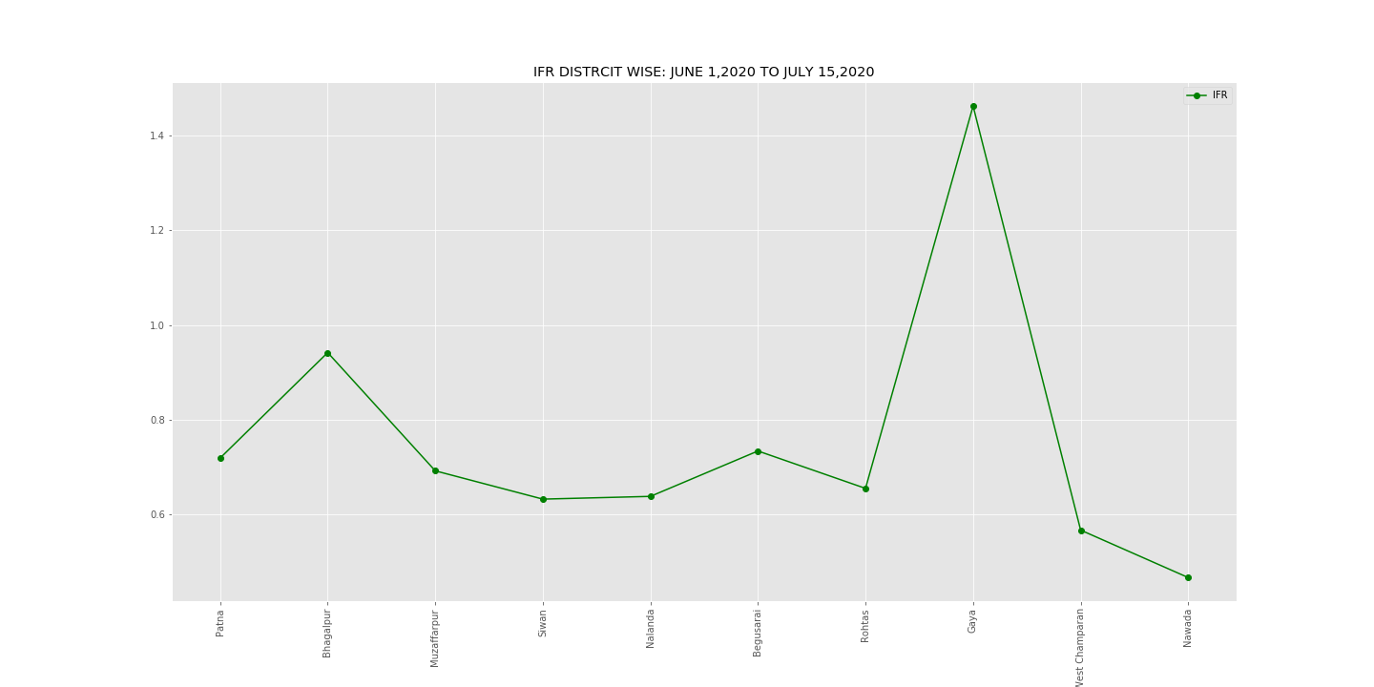
DISTRICT-WISE ANALYSIS

Slide 4
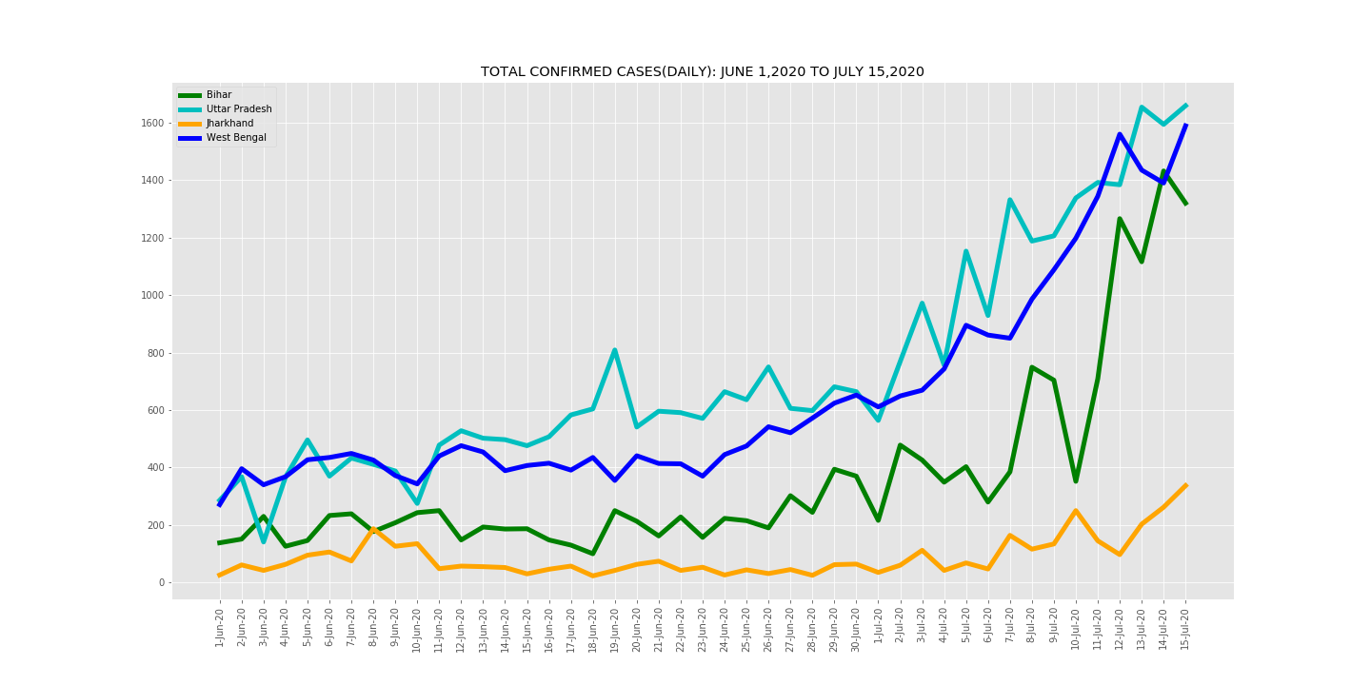
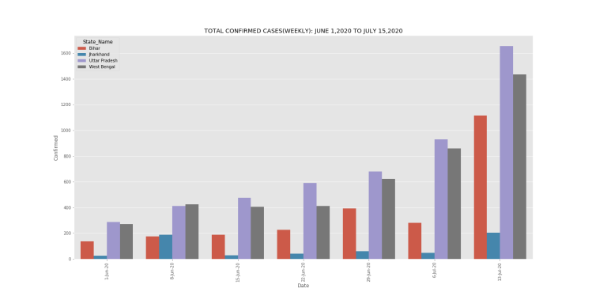
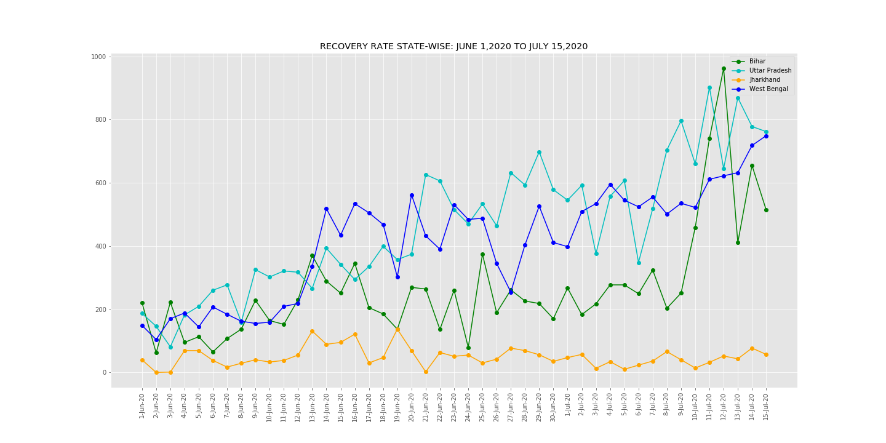
ANALYSIS OF NEIGHBOURING STATES WITH BIHAR

Slide 5
https://www.covid19india.org/ https://www.mohfw.gov.in/ https://github.com/imdevskp/covid-19-india-data https://www.kaggle.com/imdevskp/covid19-corona-virus-india-dataset
RESOURCES

